Slide 1
Social Media and the workplace
How to affectively engage with social media
January 2020
Allen Westley, Director of Cyber Intelligence

Slide 2
Social Media - Agenda
Topics
Fun Facts
Employer Responsibilities
Employee Responsibilities
Embrace Platforms Cautiously
Online Social Engineering
Develop Professional Brand
Questions

Slide 3
Social Media - Fun Facts
YouTube Stats
More video is uploaded to YouTube every month than the three major broadcasting networks created over the course of six decades
Twitter Stats
There’s a lot of empty space on Twitter. Although there are 1.3 billion Twitter accounts, only about a quarter of them – 336 million – are active every month
LinkedIn
25 million LinkedIn profiles are viewed everyday
https://www.searchenginejournal.com/social-media-facts/258533/#close

Slide 4
Social Media - Employer Responsibilities
Policy
Provide employees with access to social media policy
Conduct social media policy review annually for applicability
Procedures
Make procedures for reporting compromised social media available to employees
Training
Provide social media training to employees annually
https://www.searchenginejournal.com/social-media-facts/258533/#close

Slide 5
Social Media - Employee Responsibilities
Policy
Review social media policy
Ask questions before you act
Partner with Management, HR, Communications BU, Legal
Procedures
Understand your reporting responsibilities when compromised social media incidents happen
Training
Review social media training annually
https://www.searchenginejournal.com/social-media-facts/258533/#close

Slide 6
Social Media - Embrace Platforms Cautiously
Privacy Configuration
Review privacy settings
App updates can regress previous settings
Control your narrative
Report incidents to the vendor or service provider as soon as possible
Participate responsibly
Be a critical thinker
Act and post within your Organization’s Policy
Add employer disclaimer to your personal posts or articles
https://www.searchenginejournal.com/social-media-facts/258533/#close

Slide 7
Online Social Engineering
How does your online presence make you a target?
Who do you work for?
What is your education?
What is your expertise?
What is your favorite activity?
What sports team, tv show, or book is your favorite?
Where do you live or where have you lived?
Who do spend time with?
Where do you like to go?
When do you go there?

Slide 8
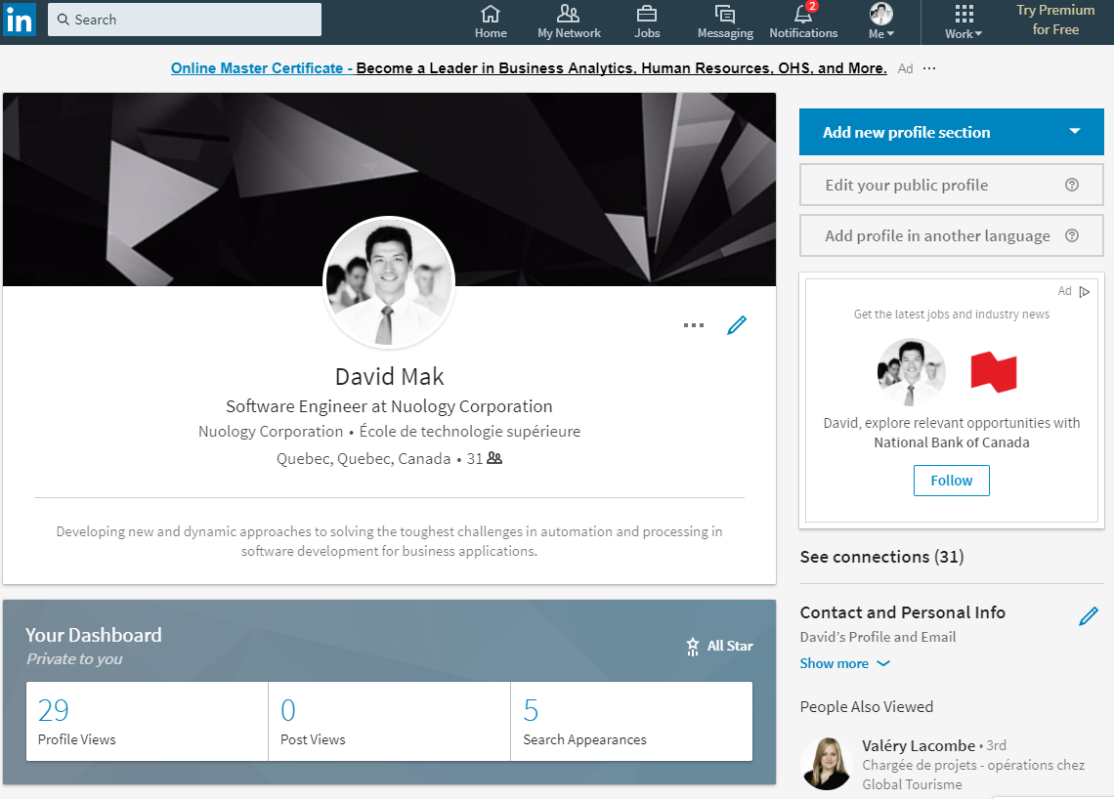
Online Social Engineering (cont.)
Social Engineering Activity, 8/16-8/24 2017 - LinkedIn
Utilize a false account simulating a Foreign Intelligence Service (David Mak)
“Stock” Photo
Foreign Affiliation

Slide 9
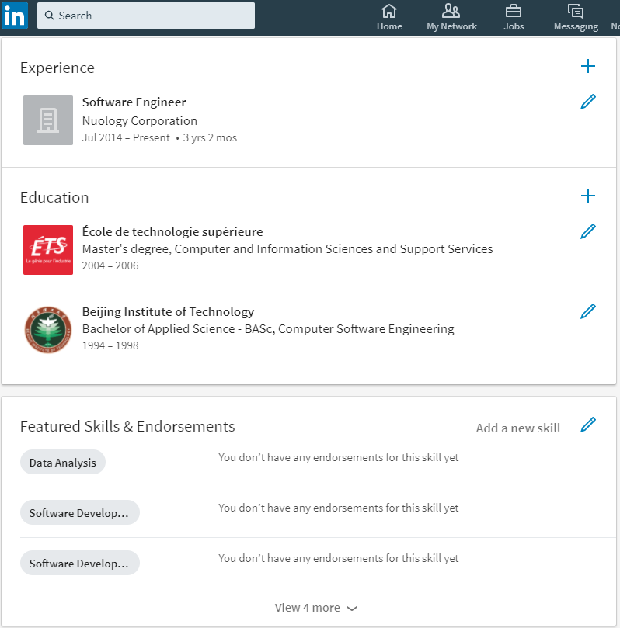
Online Social Engineering (cont.)
Social Engineering Activity - LinkedIn
Creating a false account simulating Foreign Intelligence Service (David Mak)
Similar to an actual software company in Quebec (Nulogy)
Obvious “red flag”

Slide 10
Online Social Engineering (cont.)
Timeline of Events
8/16 - Created false account on Connected with 25 Canadian LinkedIn members (random persons in the software development field)
8/21 - Initiated connection requests with employees
20 Cleared Employees
10 Uncleared Employees
8/24 – Terminated Social Engineering Activity (four business days)
Made five connections; three uncleared and two cleared (TS/SCI)
Nine views of the profile by personnel
Received one report of the activity (by a cleared CPSO)
Takeaways
17% Accepted Connection
Almost 33% viewed the profile and did not report it
Other than security personnel, zero reporting

Slide 11
Social Media – Develop a Professional Brand
Why is Branding Important
Harder to highjack an active profile
People in your network know your voice
Establish and Protect your reputation
https://www.LinkedIn.com

Slide 12
Social Media
Don’t Freak Out….QUESTIONS
https://www.searchenginejournal.com/social-media-facts/258533/#close

